Slide 1
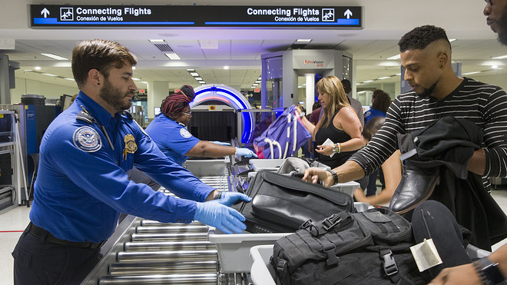
TSA CLAIMS DATA
AN INSPECTION
Group 4:
Boyang Li
Patricia Afable
Pei Xin
Vishu Gupta
Xiao Kuang
MBAN 5120
Data Programming & Management
Notes:
Image: https://ei.marketwatch.com/Multimedia/2019/07/29/Photos/ZQ/MW-HO290_denver_20190729060908_ZQ.jpg?uuid=e727627c-b1e8-11e9-8764-9c8e992d421e

Slide 2
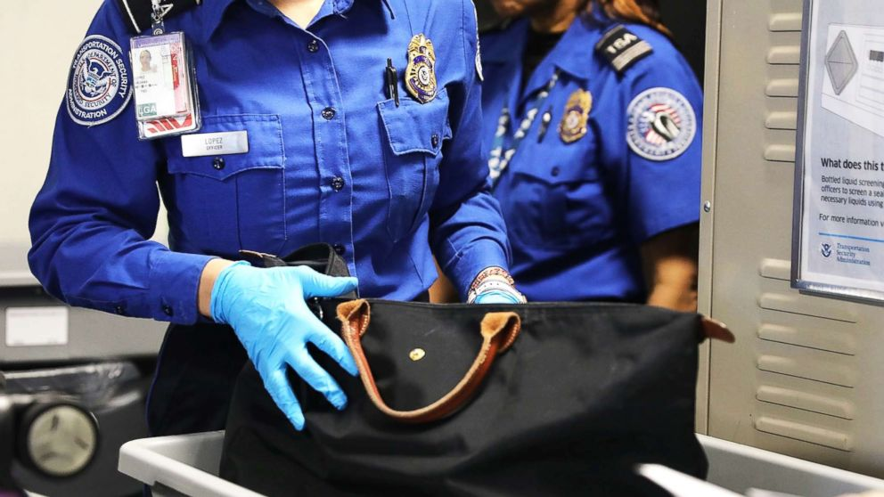



TSA Responsibilities
1.4 million checked baggage daily
5.5 million carry-on items daily
+2 million passengers daily
Notes:
Image: https://s.abcnews.com/images/US/tsa-gty-02-jpo-180710_hpMain_16x9_992.jpg

Slide 3
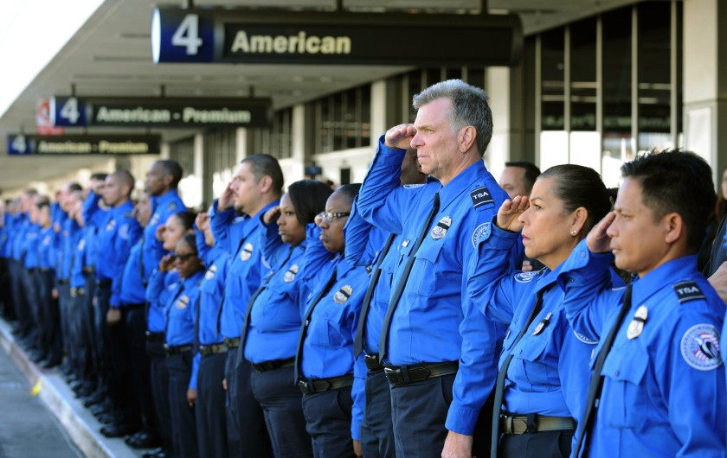


Data Processing
Extract, Transform, Load machine
Notes:
Image: https://ca-times.brightspotcdn.com/dims4/default/380242f/2147483647/strip/true/crop/2048x1292+0+0/resize/840x530!/quality/90/?url=https%3A%2F%2Fcalifornia-times-brightspot.s3.amazonaws.com%2Fcd%2Fd6%2F86abdcdd52ea2b780870efd0212a%2Fla-xpm-photo-2013-nov-07-la-oe-jenkins-arming-tsa-20131107

Slide 4
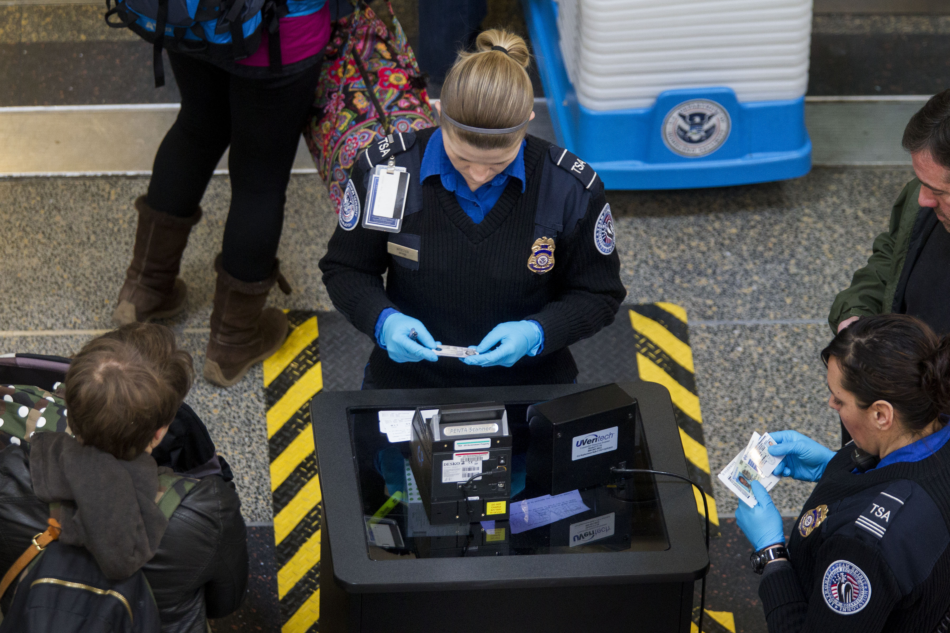
Data Cleaning Process
Create a library and import the TSA Claims Data
Data Exploration and Finding Issues for Analysis
Column Attributes and Structure of Dataset
Start
Missing Values Replacement in Dataset
Categorizing Data Issues
Sorting by Incident_Date and Exporting
End
Notes:
Image: https://content.fortune.com/wp-content/uploads/2015/06/gettyimages-464375210.jpg

Slide 5
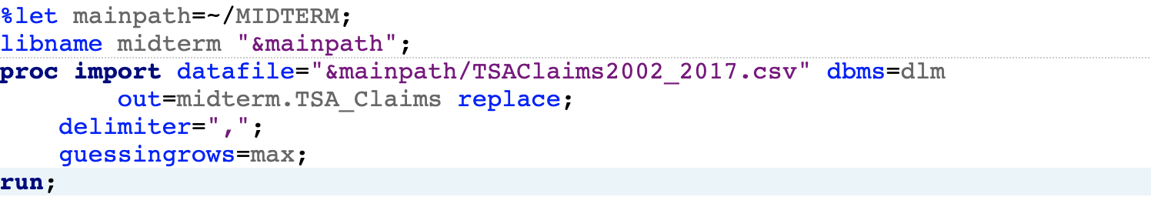
Data Cleaning Process
Create a library and import the TSA Claims Data
Data Exploration and
Finding Issues for
Analysis
Column Attributes and Structure of Dataset
Start
Missing Values
Replacement in Dataset
Categorizing Data Issues
Sorting by Incident_Date and Exporting
End

Slide 6
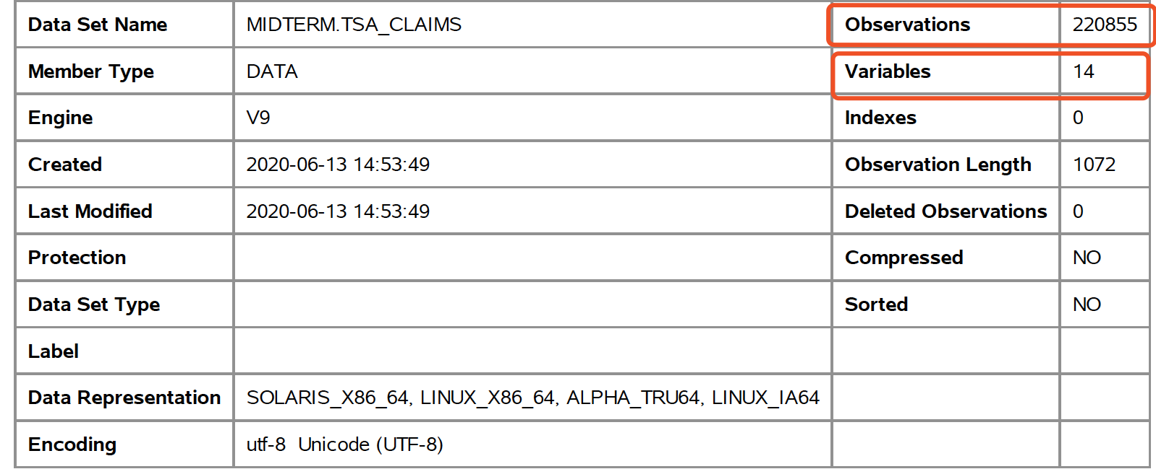
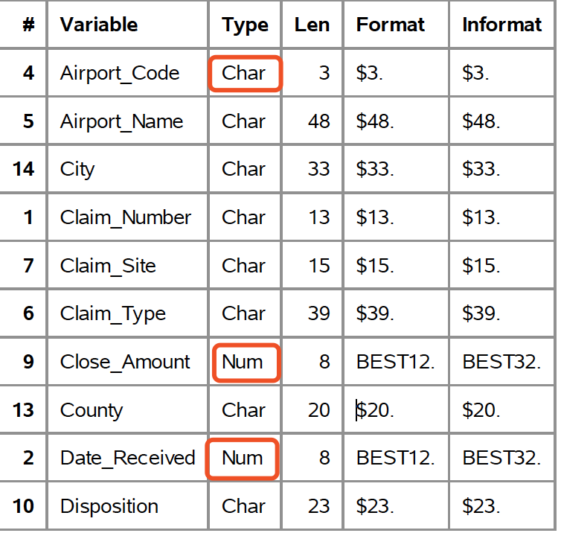
Data Cleaning Process
Create a library and import the TSA Claims Data
Data Exploration and
Finding Issues for
Analysis
Column Attributes and Structure of Dataset
Start
Missing Values
Replacement in Dataset
Categorizing Data Issues
Sorting by Incident_Date and Exporting
End
Notes:
Conclusion: From the content tables, we can see that there are 14 variables(columns) and 220855
observations(rows) in this data set, among these variables, three are numeric, and Incident_Date and
Date_Recieved should be SAS date, while the other 11 variables are characteristic.

Slide 7
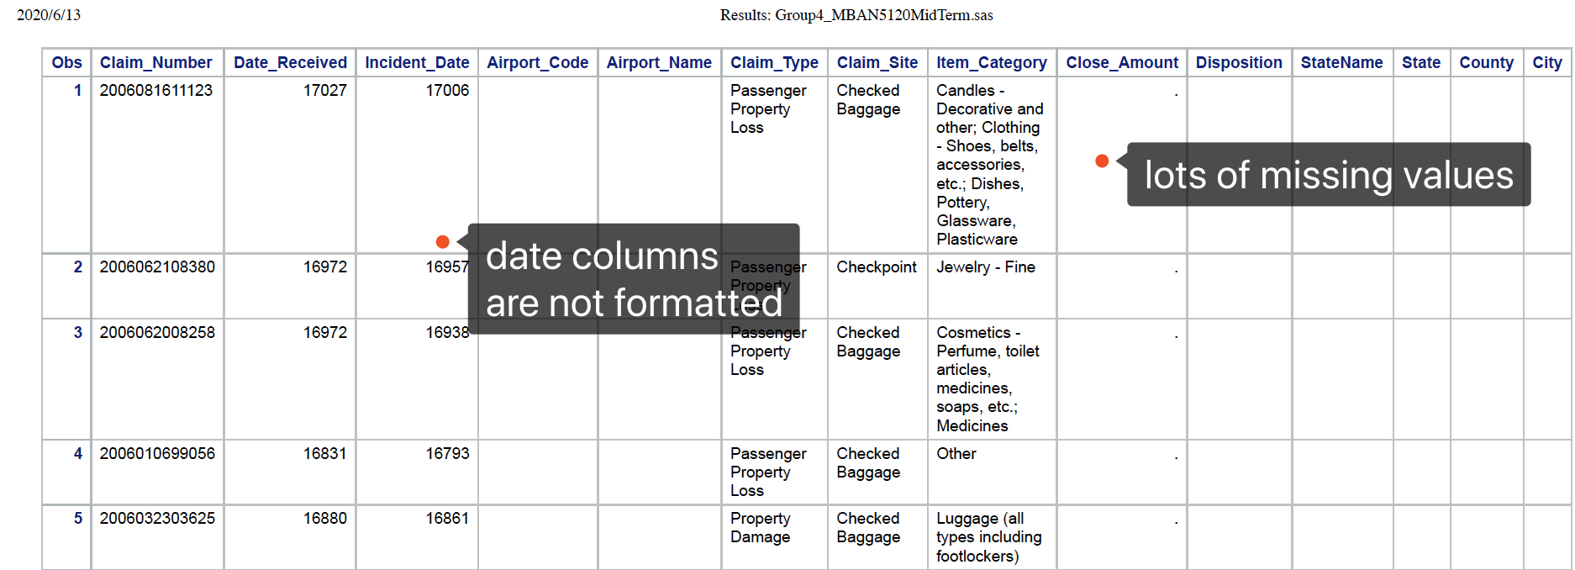
Data Cleaning Process
Create a library and import the TSA Claims Data
Data Exploration and
Finding Issues for
Analysis
Column Attributes and Structure of Dataset
Start
Missing Values
Replacement in Dataset
Categorizing Data Issues
Sorting by Incident_Date and Exporting
End
Notes:
Even though we only print out the first 5 rows of the whole data set, it is obvious that the data set is not ideal: missing data can be
seem in almost every column, Date_Received and Incident_Date are presented as numbers rather than date formatted.

Slide 8
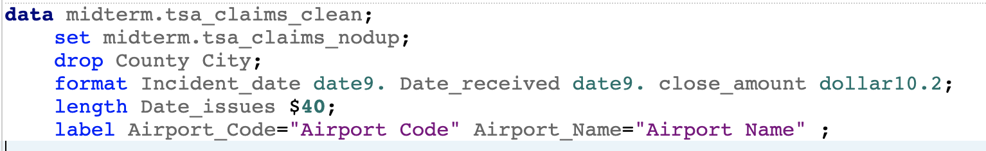
Data Cleaning Process
Create a library and import the TSA Claims Data
Data Exploration and
Finding Issues for
Analysis
Column Attributes and Structure of Dataset
Start
Missing Values
Replacement in Dataset
Categorizing Data Issues
Sorting by Incident_Date and Exporting
End
Notes:
We used keywords drop, format, length, label to alter the column attributes and change the structure of our new data set, tsa_claims_clean

Slide 9
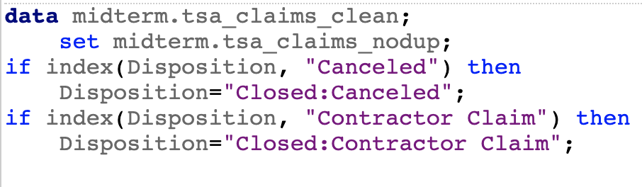
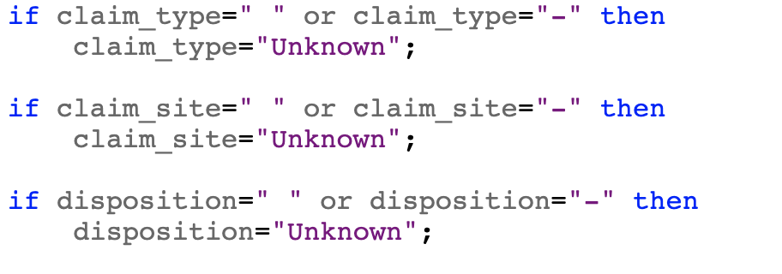
Data Cleaning Process
Create a library and import the TSA Claims Data
Data Exploration and
Finding Issues for
Analysis
Column Attributes and Structure of Dataset
Start
Missing Values
Replacement in Dataset
Categorizing Data Issues
Sorting by Incident_Date and Exporting
End
Notes:
IF-THEN statement is used to cut the redundant categories in Columns disposition and claim_type
And also used to change missing values into “unknown” for claim_type,claim_site,disposition,
We also do some extra work to fill missing values in airport_code,airport_name,state,state_name.

Slide 10
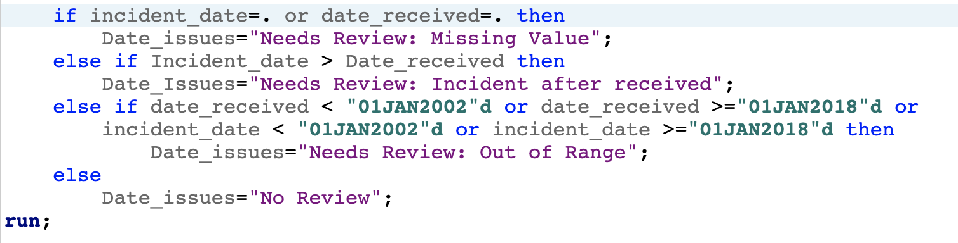
Data Cleaning Process
Create a library and import the TSA Claims Data
Data Exploration and
Finding Issues for
Analysis
Column Attributes and Structure of Dataset
Start
Missing Values
Replacement in Dataset
Categorizing Data Issues
Sorting by Incident_Date and Exporting
End
Notes:
Three different kinds of date issues are defined and categorized with IF-ELSEIF-ELSE statement.

Slide 11
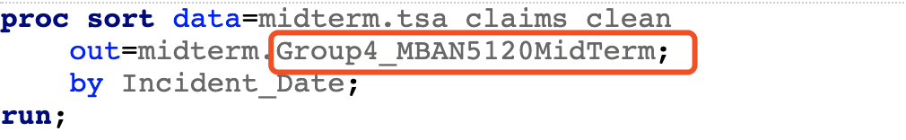
Data Cleaning Process
Create a library and import the TSA Claims Data
Data Exploration and
Finding Issues for
Analysis
Column Attributes and Structure of Dataset
Start
Missing Values
Replacement in Dataset
Categorizing Data Issues
Sorting by Incident_Date and Exporting
End
Notes:
After sorted by incident_date, we get our final clean version.

Slide 12
Reporting Results

Slide 13
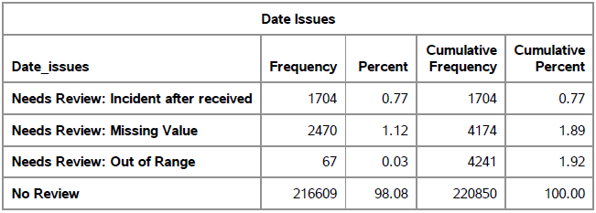
Date Issues

Slide 14
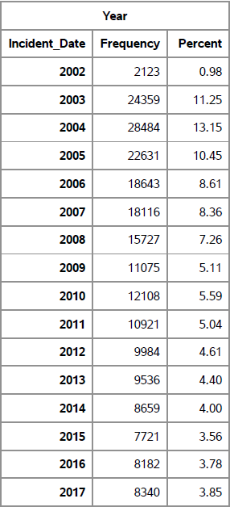
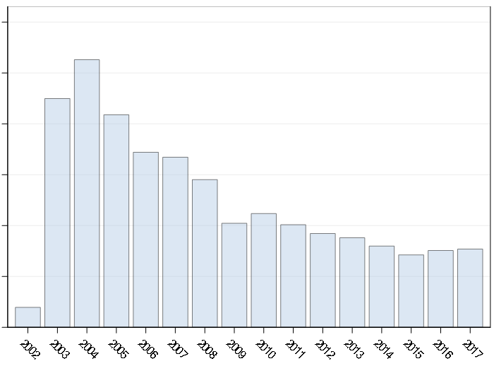
Incident Date

Slide 15
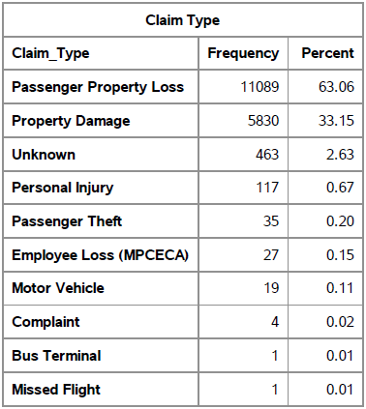
Claim Type
96.21%
Selected State: NY

Slide 16
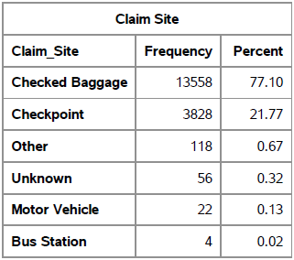
Claim Site
98.87%
Selected State: NY

Slide 17
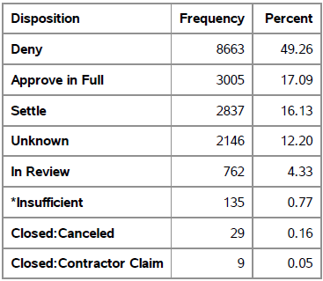
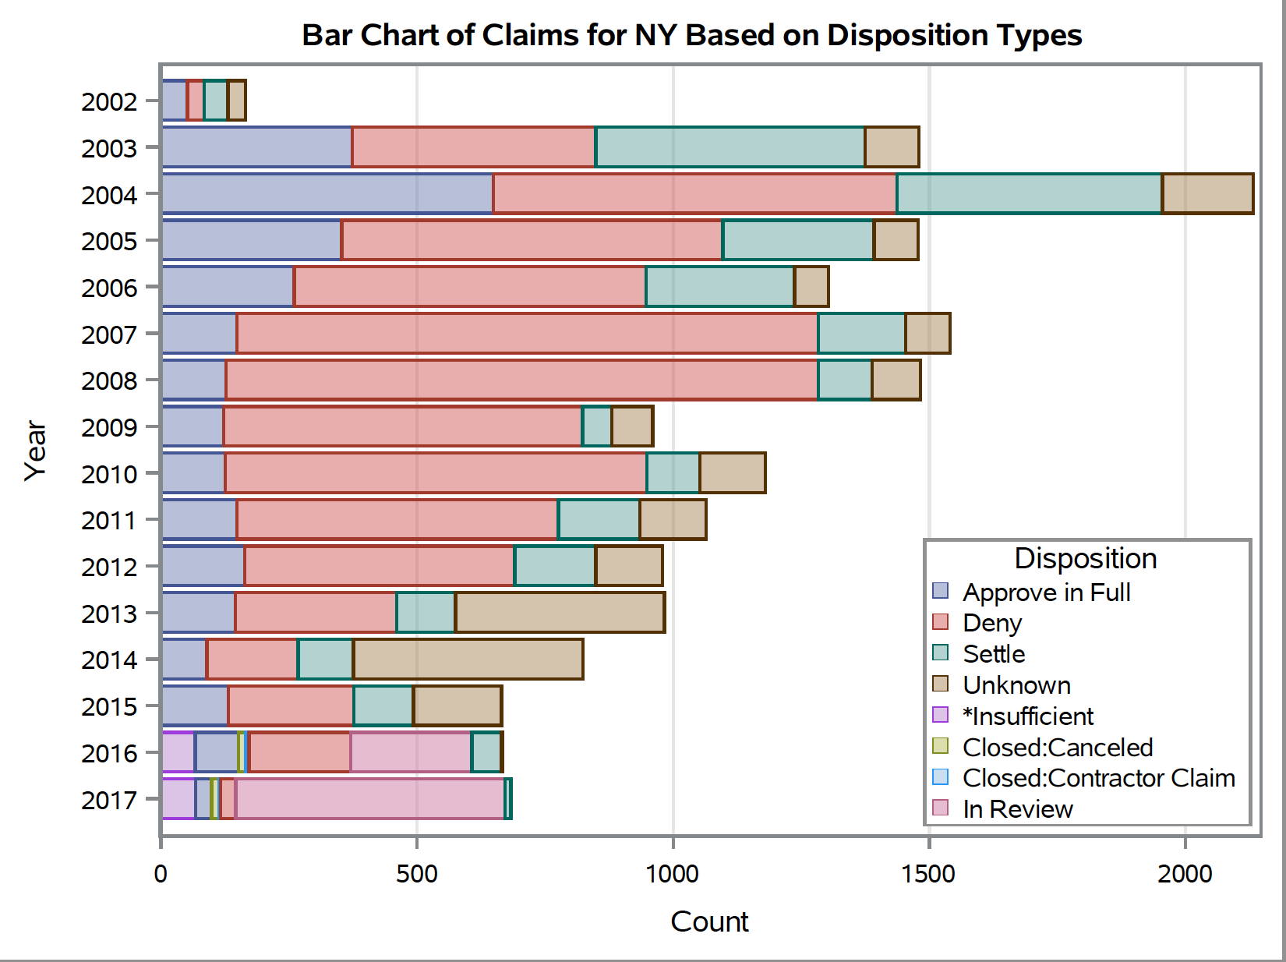
Disposition
Selected State: NY

Slide 18
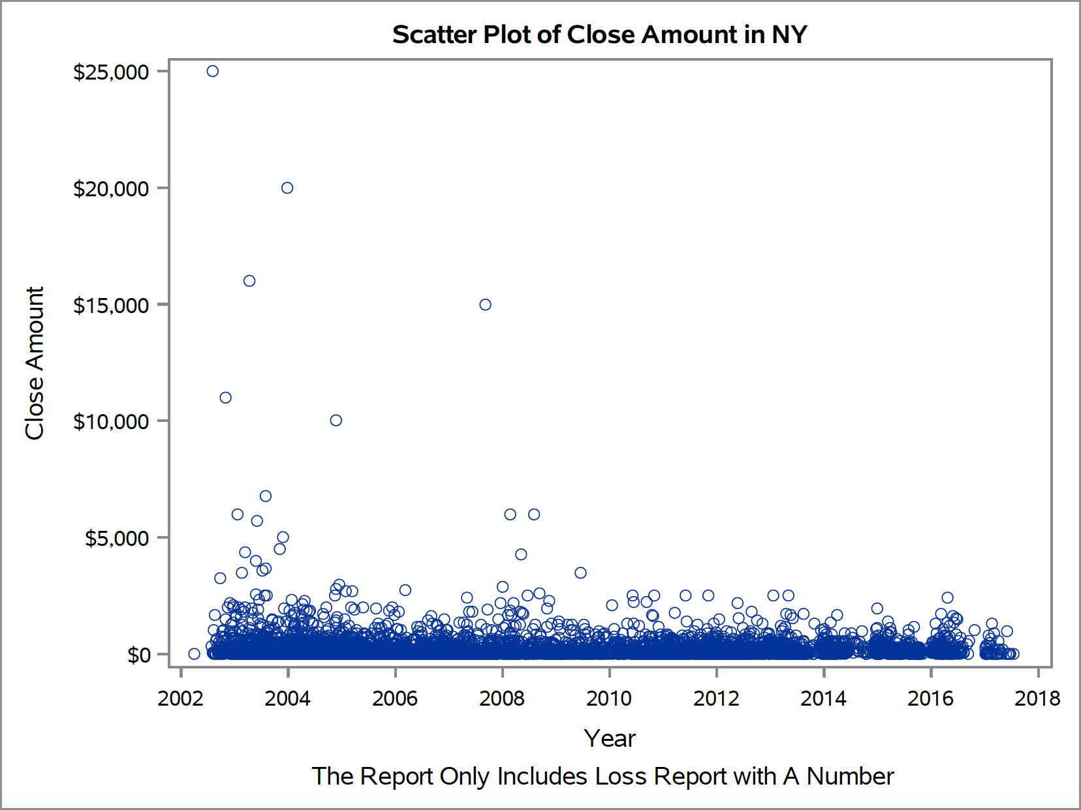
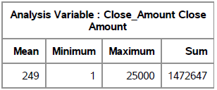
Close Amount
Selected State: NY

Slide 19
Recommendations

Slide 20
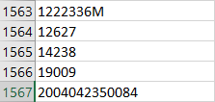
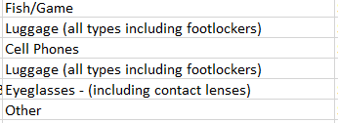
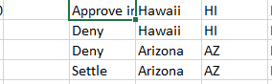
Issues with Raw Data
Inconsistency in Claim_Number and Item_Category
Close_Amount is missing in many claims
Redundant categories for multiple columns
Missing values for multiple columns: airport_code, airport_name, state, state_name
Dates are not formatted
Different types of Date_Issue:
Missing dates
Illogical dates
Dates out of proper range

Slide 21
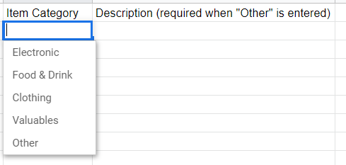
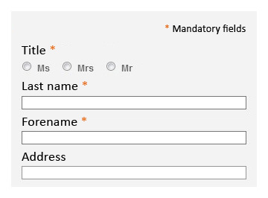
Standardize Data Entry
Encourage online claim request
Send supporting documents digitally
Automated entry for dates, state and airport details
Predefined values for item_category
Mandatory Fields to fill
Notes:
https://www.google.com/url?sa=i&url=https%3A%2F%2Fwww.accede-web.com%2Fen%2Fguidelines%2Fdesign%2Fforms%2Fmandatory-fields%2F&psig=AOvVaw2S0jvg693-w2d_c-LpF9H9&ust=1591996493145000&source=images&cd=vfe&ved=0CAMQjB1qFwoTCKif5p_X-ukCFQAAAAAdAAAAABA0

Slide 22

Include Close Date for Claims
If a claim case is unresolved 6 months after being presented to TSA, passengers have the right to bring the case to District Court.
Notes:
https://www.google.com/url?sa=i&url=https%3A%2F%2Fwww.lorecreative.co.uk%2Farticle%2F6-months-and-counting-until-your-autumn-open-days%2F&psig=AOvVaw0Vu31CMXKHvkNT18Lf-XJ1&ust=1592021707773000&source=images&cd=vfe&ved=0CAMQjB1qFwoTCPC3i5i1--kCFQAAAAAdAAAAABAJ
https://www.tsa.gov/travel/passenger-support/claims

Slide 23
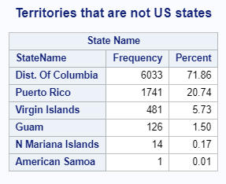
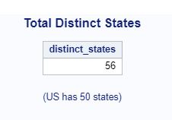
Change Column Name
Consider using “StateName_and_Territories” as columns name to avoid confusion

Slide 24
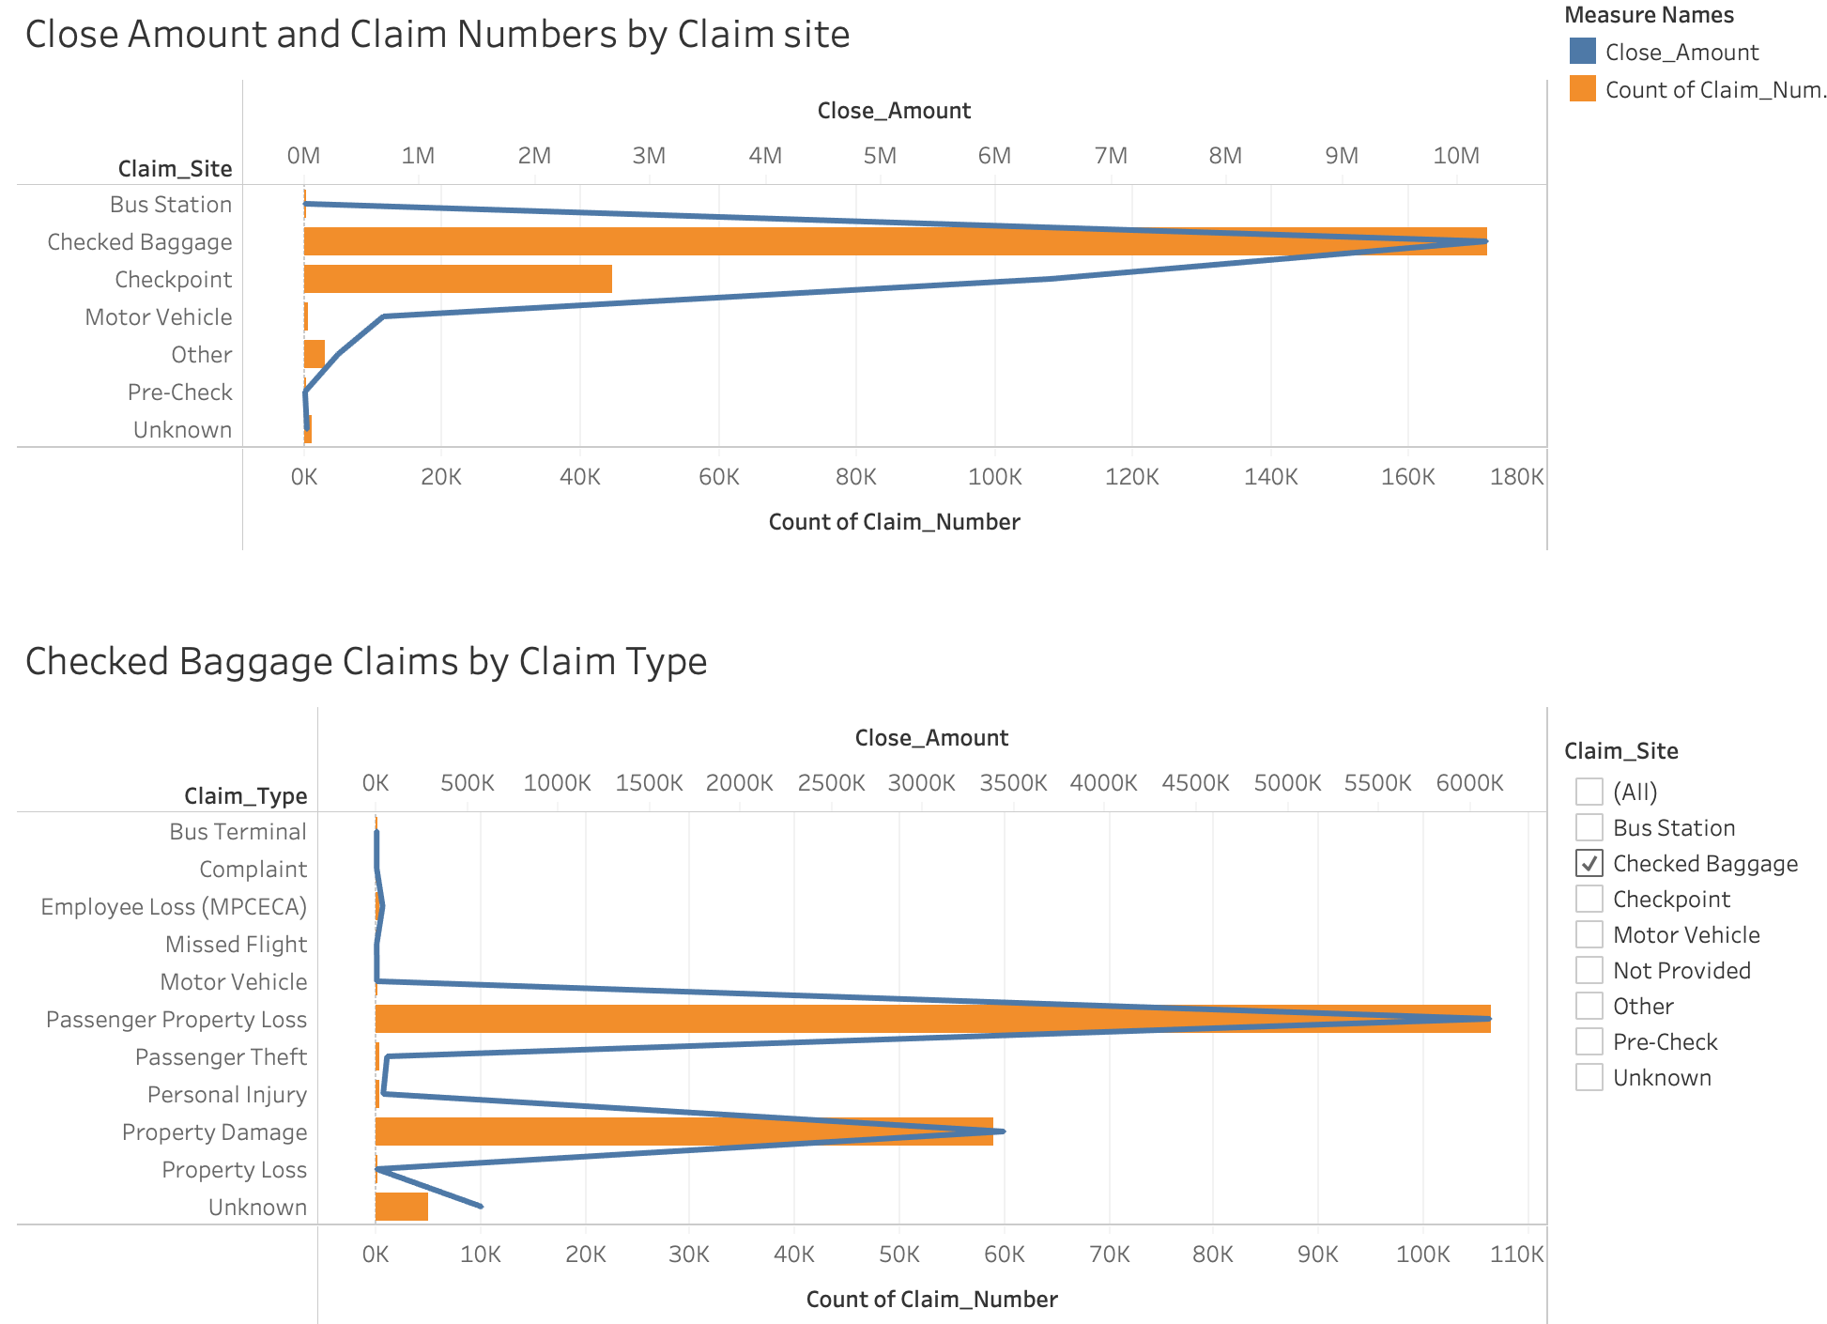
Liability Insurance
The claim site of Checked Baggage has the highest close amount and claim numbers
Among claims of Checked Baggage, Passenger Property Loss and Property Damage constitute the majority.

Slide 25


Benefits
Of Recommendations
Data Quality
Streamline Data
Shorter Processing Time
Lower Close Amount
Notes:
Icons made by <a href="https://www.flaticon.com/free-icon/pipeline_2898713?term=pipeline&page=1&position=10" title="itim2101">itim2101</a> from <a href="https://www.flaticon.com/" title="Flaticon"> www.flaticon.com</a>
Icons made by <a href="https://www.flaticon.com/authors/wichaiwi" title="Wichai.wi">Wichai.wi</a> from <a href="https://www.flaticon.com/" title="Flaticon"> www.flaticon.com</a>

Slide 26
Q & A Session

